Slide 1



Web Technologies
Basic Concepts
Svetlin Nakov
Technical Trainer
www.nakov.com
Software University
http://softuni.bg

Slide 2
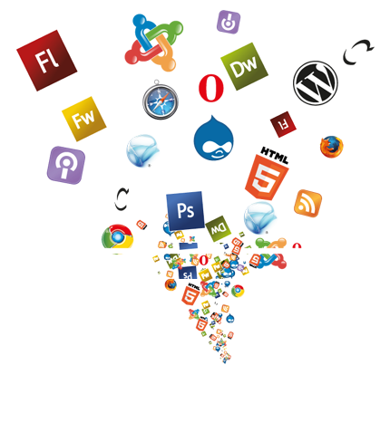

Table of Contents
Web pages, Web Sites and Web Applications
Web 1.0, 2.0, 3.0
Web Browsers and Layout Engines
Hardware Servers
Web Servers
Client-Server Architecture
3-Tier / Multi-Tier Architectures
Service-Oriented Architecture & Cloud

Slide 3

Web Pages, Sites and Applications

Slide 4
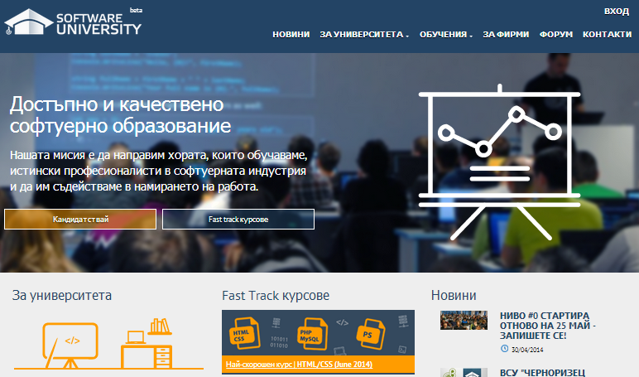
Web Page
Web document that is suitable for web browsers
Can be accessed through every device
Only Internet and Web browser is required
Web pages are usually written in HTML or XHTML
May contain text, graphics, hyperlinks, references to other resources
Stylesheets, scripts, images

Slide 5
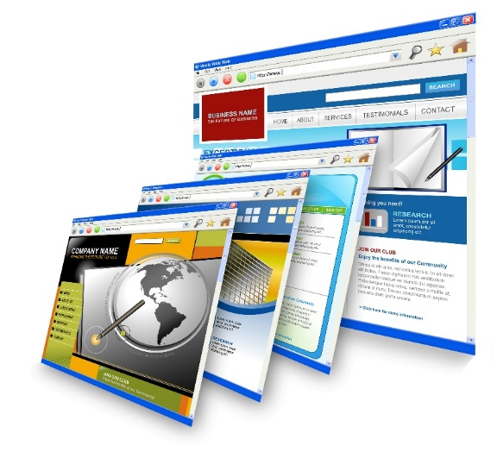
Web Site
Set of related web pages served from a single web domain
Hosted on one or more web servers (accessible via network)
Web sites consist of set of resources
Web pages, CSS styles, JS scripts, images, videos, …
World Wide Web (WWW)
All publicly accessible websites in Internet

Slide 6



Web Application / RIA / SPA
Software application that runs in a Web browser
Or is created in a browser-supported language (HTML + CSS + JS)
Applications are usually broken into logical chunks called "tiers"
High interactivity and accessibility
Allows personalized dynamic content to be pulled down by users
According to individual settings

Slide 7

Web Browsers and Layout Engines

Slide 8
Web Browser
Web browsers visualize Web content
Render HTML, images, CSS, videos, JavaScript, etc.
Software application for retrieving, presenting and traversing information resources on the World Wide Web
An information resource is identified by a URI / URL and may be a web page, image, video or other piece of content
Can used to access information provided by web servers in private networks or files in file systems

Slide 9
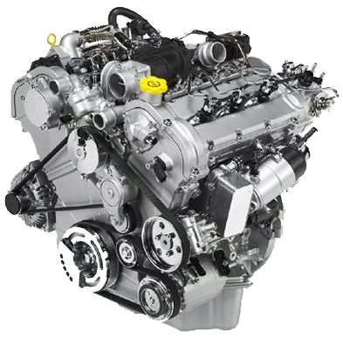
Layout Engine
Takes marked up content (HTML, XML, images, files, ...) + formatting information (CSS, XSL, …)
Displays the formatted content on the screen
A layout engine is typically embedded in web browsers, e-mail clients, e-book readers, on-line help systems
To display Web content
Different devices run different layout engines
Render HTML and CSS differently

Slide 10










Layout Engines and Web Browsers
Blink
Chrome, Opera 15+
Gecko
Firefox, Netscape, SeaMonkey, …
Trident
Internet Explorer, Maxthon
WebKit
Old Chrome, Safari
Presto and others
Old Opera

Slide 11
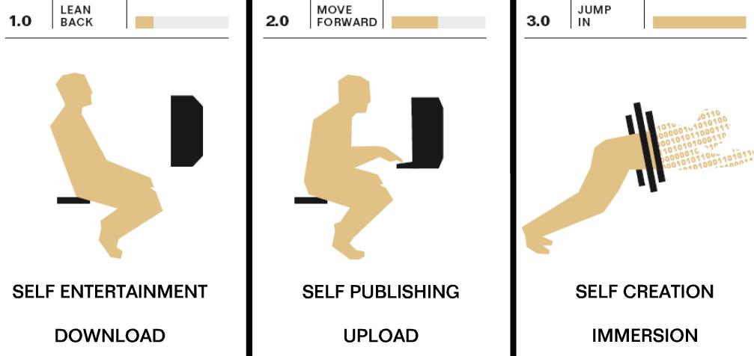
Web Evolution – History and Future
Web 1.0 – 4.0

Slide 12
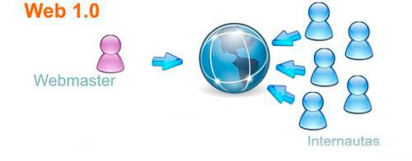
Web 1.0
Experts call the Internet before 1999 “Read-Only” web
Sites are static. They might contain useful information, but there's no reason for a visitor to return to the site later.
Low variety of content
Sites aren’t interactive
Applications are proprietary
10 000 editors server 500 millions internet users

Slide 13
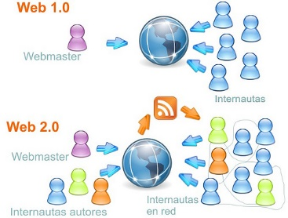
Web 2.0
The writing and participating web (User-generated content)
New applications may allow every users to interact and collaborate with each other in a social media dialogue as creators of content
What is Web 2.0?
Rich Internet Applications (RIA)
Social Web
Web-Oriented Architecture (WOA)
RSS, Web services, feeds, etc.

Slide 14
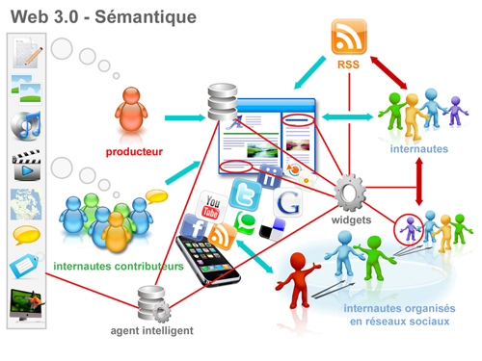
Web 3.0
"Semantic Web" is sometimes used as a synonym for "Web 3.0“
The Web 3.0 browser will analyze your response, search the Internet for all possible answers, and then organize the results for you
Artificial intelligence
Personalization
Mobility
Semantic Web

Slide 15
Web 4.0
“The next Web” – the ultra-intelligent electronic agent
Recognize you when you get in front of it because all of your devices are getting a little camera
And with facial recognition, they’ll know it’s you
Web 4.0 is often characterized as the Web OS
The entire web being a single operating system where information flows from any one point to any other

Slide 16
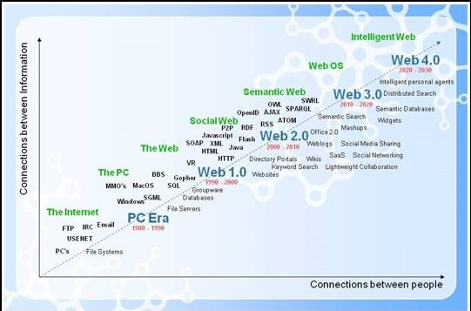
Web Evolution
http://www.evolutionoftheweb.com/

Slide 17
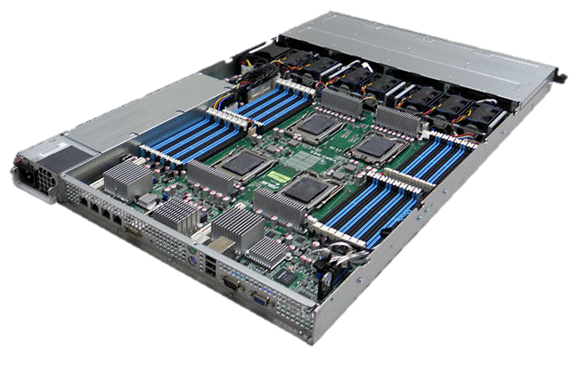
Hardware Servers

Slide 18
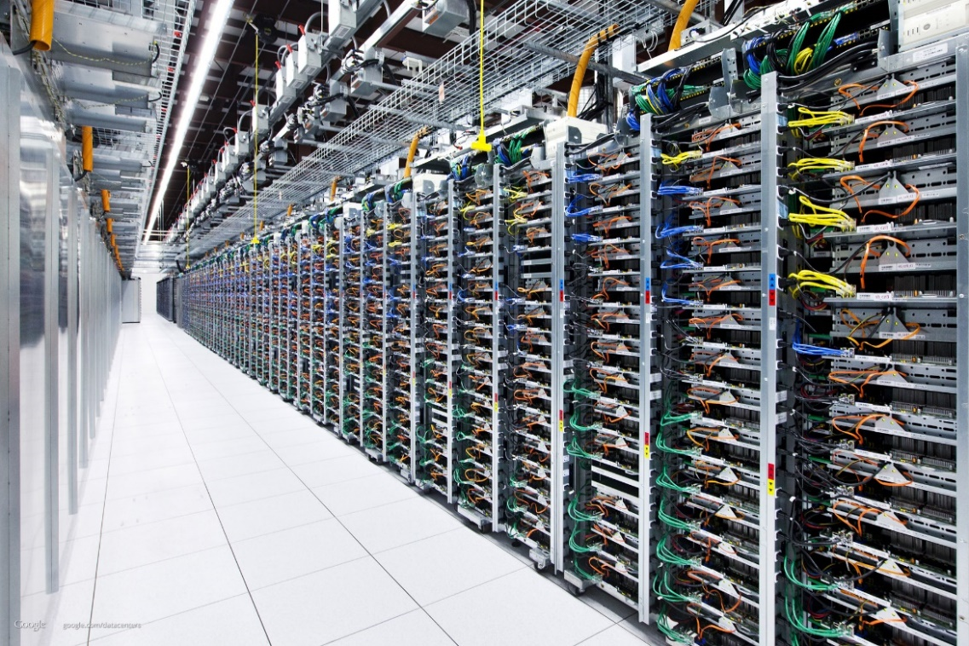
Hardware Server
Physical computer (a hardware system) dedicated to running one or more such services
Usually servers are placed in data centers
Typical computing servers are:
Database server
File server
Mail server
Web server

Slide 19
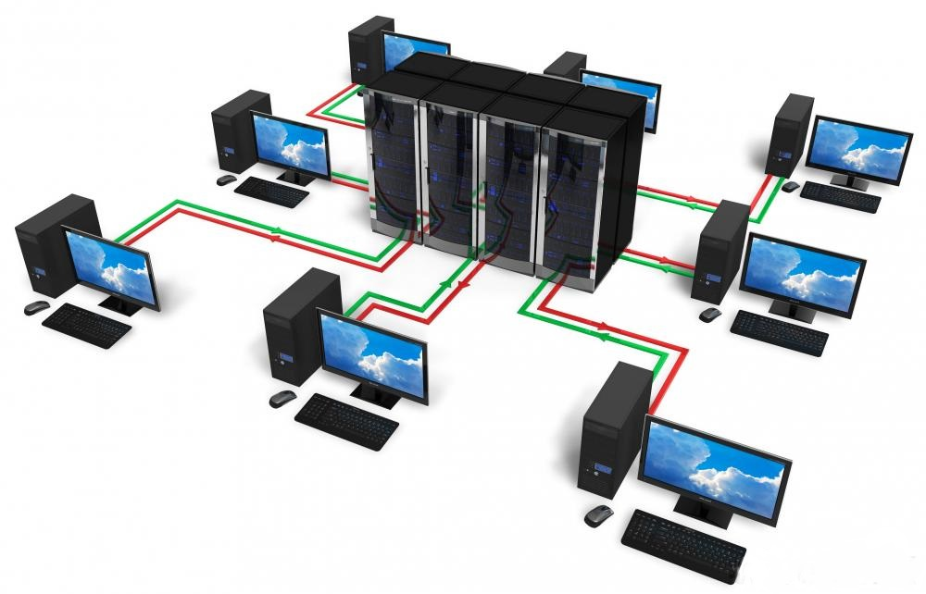
Web Servers
Apache, IIS, nginx, lighttpd

Slide 20
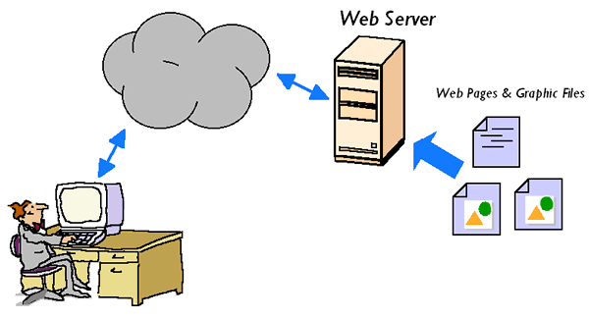
Web Server
The primary function of a web server is to store, process and deliver web pages to clients
Handle web requests
Serve web content
The communication between client and server takes place using the HTTP
These requests are redirected to other software products (ASP.NET, PHP, etc.), depending on the web server settings

Slide 21
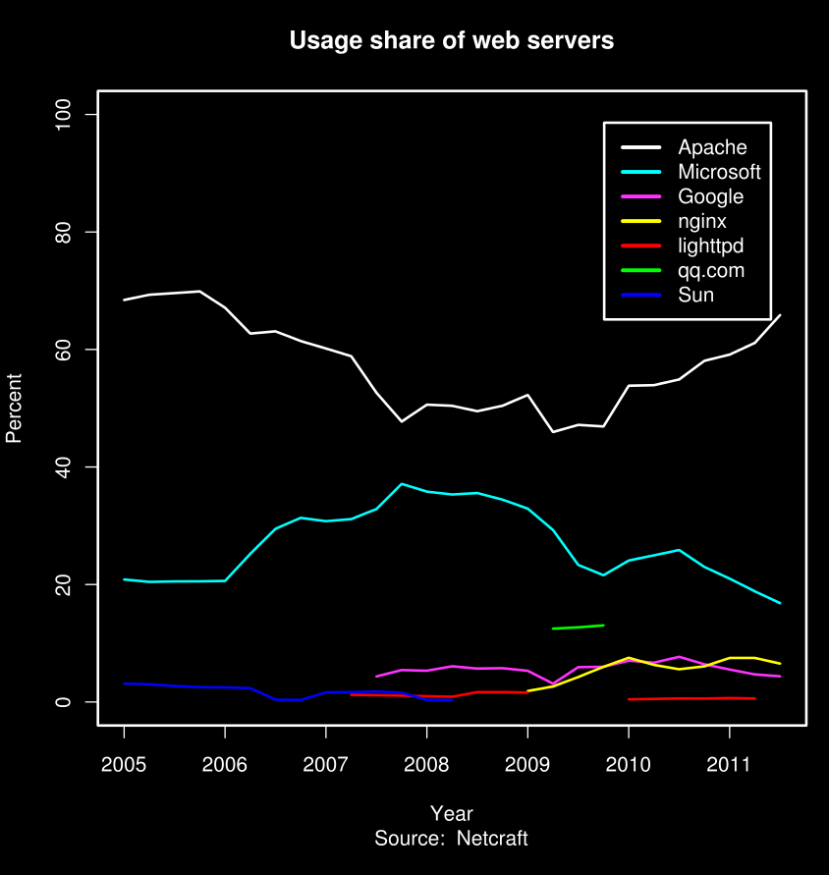
Web Servers Market Share – Feb 2014
Apache
38.22 %
IIS (by Microsoft)
32.80%
nginx (by Igor Sysoev)
15.00%
GWS (by Google)
2.30%

Slide 22
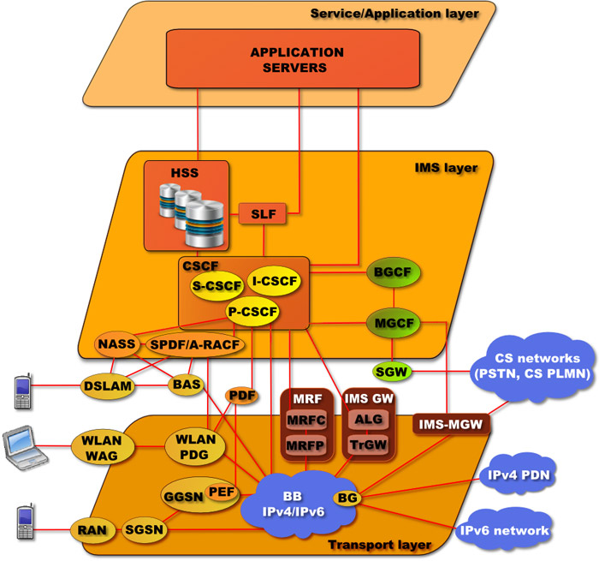
Software Architectures
Client-Server, Multi-Tier, SOA

Slide 23
Client-Server Architecture
Networks in which certain computers have special dedicated tasks. The client-server model consists of:
Server – a single machine or cluster of machines that provides web applications (or services) to multiple clients
Examples: IIS web server, WCF based service, cloud services
Client – software applications that provide UI (front-end) to access the services at the server
Examples: Web browser, WPF application, HTML5 application, Mobile application, Silverlight application…

Slide 24
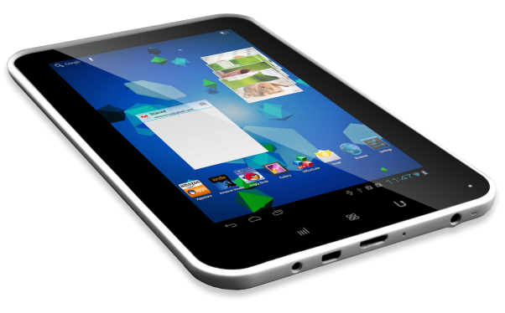
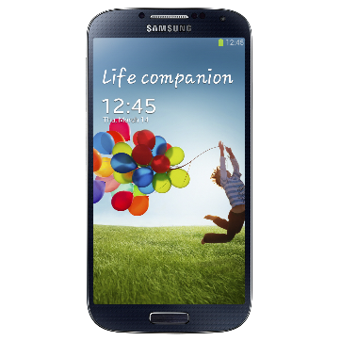
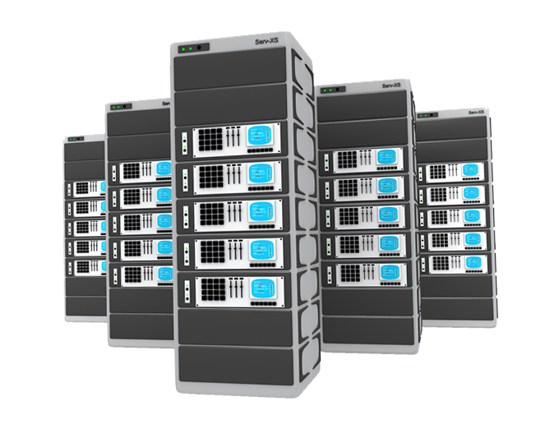
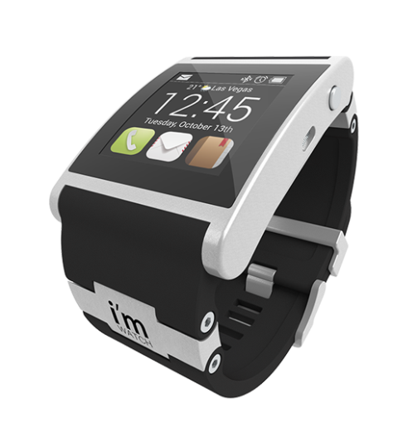

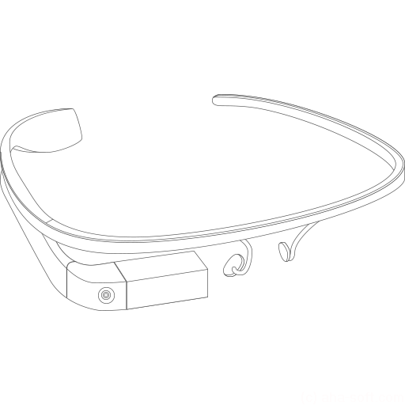
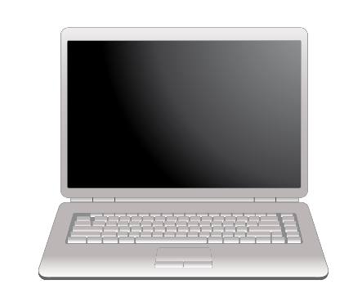
Client-Server Architecture
Client
Client
Server
Client
Client
network connection
network connection
network connection
Client
Client

Slide 25
Client-Server Model – Examples
Web server (Apache, IIS) – Web browser
FTP server (ftpd) – FTP client (FileZilla)
EMail server (qmail) – email client (Outlook)
SQL Server – SQL Server Management Studio
BitTorrent Tracker – Torrent client (μTorrent)
DNS server (bind) – DNS client (resolver)
DHCP server (wireless router firmware) – DHCP client (mobile phone /Android DHCP client/)
SMB server (Windows) – SMB client (Windows)

Slide 26
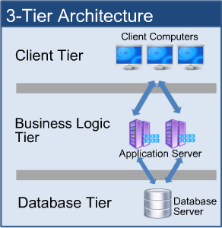
3-Tier / Multi-Tier Architectures
Three-tier architecture consists of the following layers:
Presentation layer (front-end)
Responsible for visualizing information
Provides the UI of the application
Application layer (business tier)
Responsible for application functionality
Provides the system logic
Data layer (back end)
Manages the data of the system

Slide 27
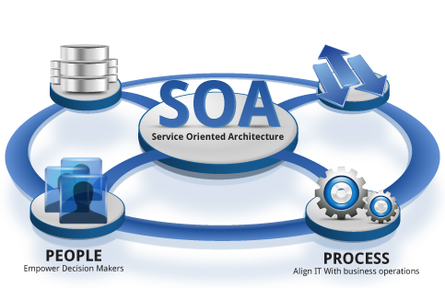
Service-Oriented Architecture (SOA)
Design pattern based on discrete pieces of software providing application functionality as services to other applications
Independent of any vendor, product or technology
Known as service-orientation
What is service?
A piece of work performed by a service provider
Provides the client some desired result by some input parameters
Has quality characteristics (price, execution, time, etc.)

Slide 28
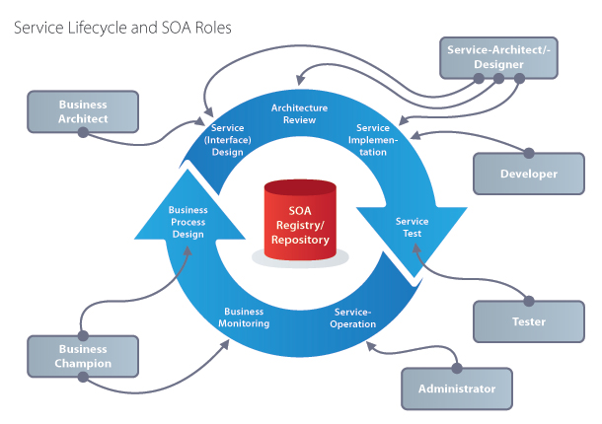
Service-Oriented Architecture (SOA)

Slide 29





What is "Cloud"?

Slide 30
What is Cloud?
Cloud ≈ multiple hardware machines combine their computing power and resources
Share them between multiple applications
To save costs and use resources more efficiently
Public clouds
Provide computing resources on demand
Publicly in Internet
Paid or free of charge (to some limit)
Amazon AWS, Google App Engine, Microsoft Azure, Rackspace, AppFog, Heroku, AppHarbor, …

Slide 31
Cloud Computing Models
Infrastructure as a Service (IaaS)
Virtual machines in the cloud on demand
Users install the OS and software they need
Platform as a Service (PaaS)
Platform, services and APIs for developers
E.g. Java + JBoss + JSF + JPA + MongoDB or JavaScript + Node.js + MongoDB + RabbitMQ
Software as a Service (SaaS)
Hosted application on demand (e.g. WordPress)

Slide 32

Summary
Web pages == formatted text with images and hyperlinks
Web browser == visualizer for Web pages
Web site == a set of Web pages, styles and resources
Hardware Servers are machines that run the IT infrastructure
Cloud == computing resources in a data center
Web Servers == software serving Web content
Client-server architecture == device connects to a server

Slide 33
Web Technologies – Basic Concepts
http://softuni.org/courses

Slide 34
License
This course (slides, examples, demos, videos, homework, etc.) is licensed under the "Creative Commons Attribution-NonCommercial-ShareAlike 4.0 International" license
Attribution: this work may contain portions from
"HTML Basics" course by Telerik Academy under CC-BY-NC-SA license
"CSS Styling" course by Telerik Academy under CC-BY-NC-SA license

Slide 35





Free Trainings @ Software University
Software University Foundation – softuni.org
Software University – High-Quality Education, Profession and Job for Software Developers
softuni.bg
Software University @ Facebook
facebook.com/SoftwareUniversity
Software University @ YouTube
youtube.com/SoftwareUniversity
Software University Forums – forum.softuni.bg

